Slide 1

2024 Southwest Fire Ecology – Santa Fe
Visualizing Santa Fe’s Science of Complexity
simtable
stephenguerin@fas.harvard.edu
stephen.guerin@simtable.com
505-577-5828
Visualization Research and Teaching Lab Department of Earth and Planetary Sciences

Slide 2
SELF-ORGANIZATION

Slide 3
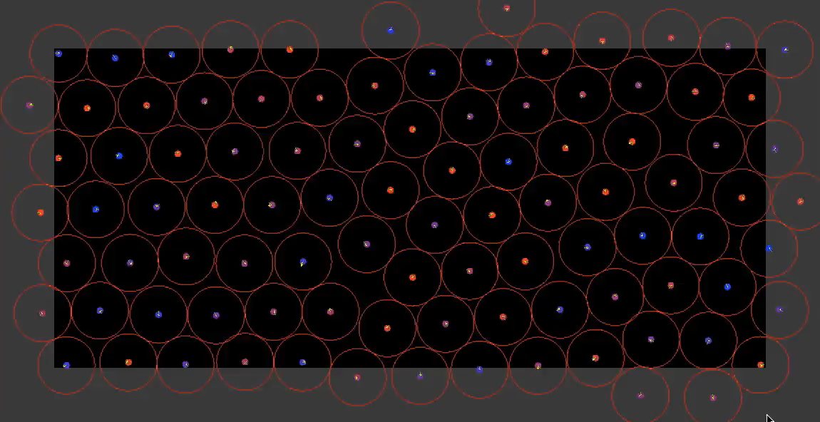

Slide 4
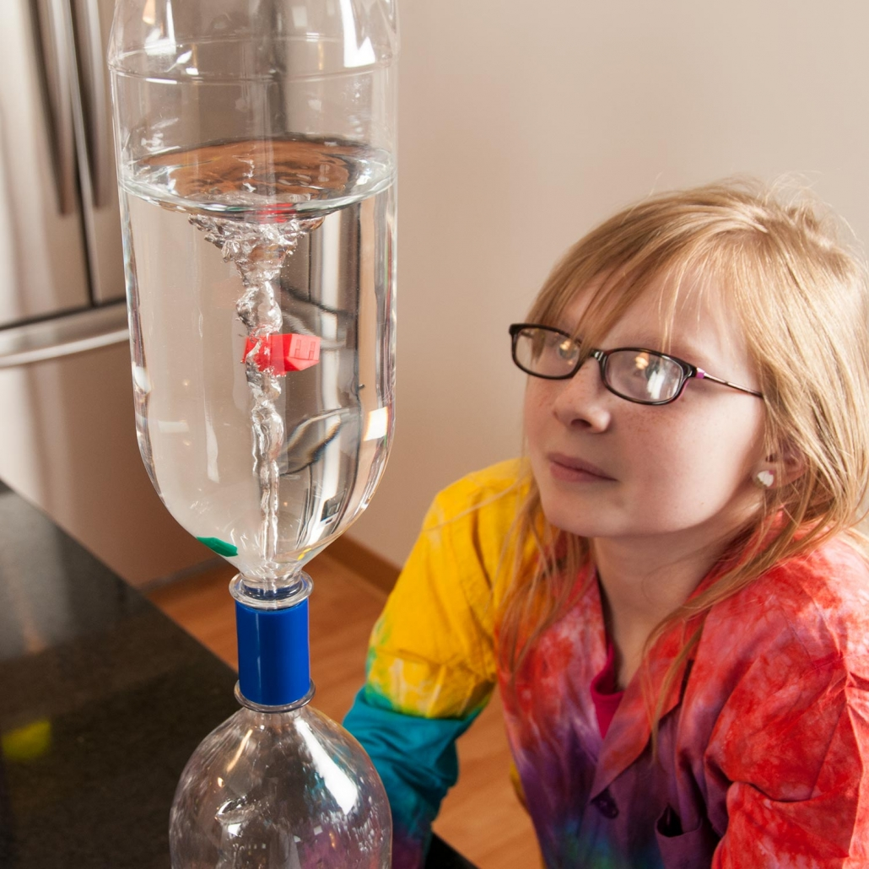

Slide 5
COLLECTIVE INTELLIGENCE

Slide 6
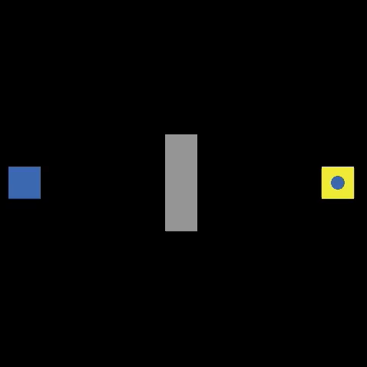

Slide 7
CRITICALITY

Slide 8
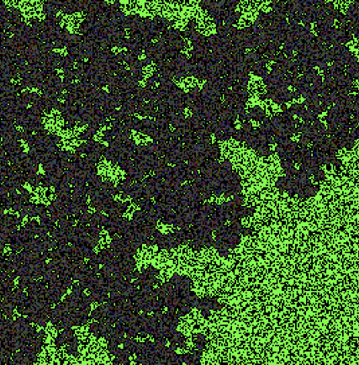
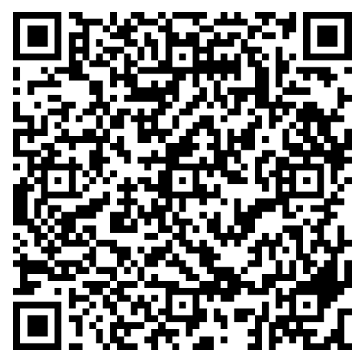
experiment: 22319
https://firesweep.simtable.com

Slide 9
COMPUTATION

Slide 10
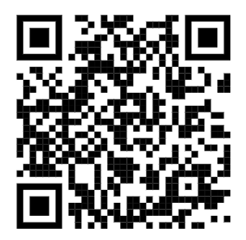
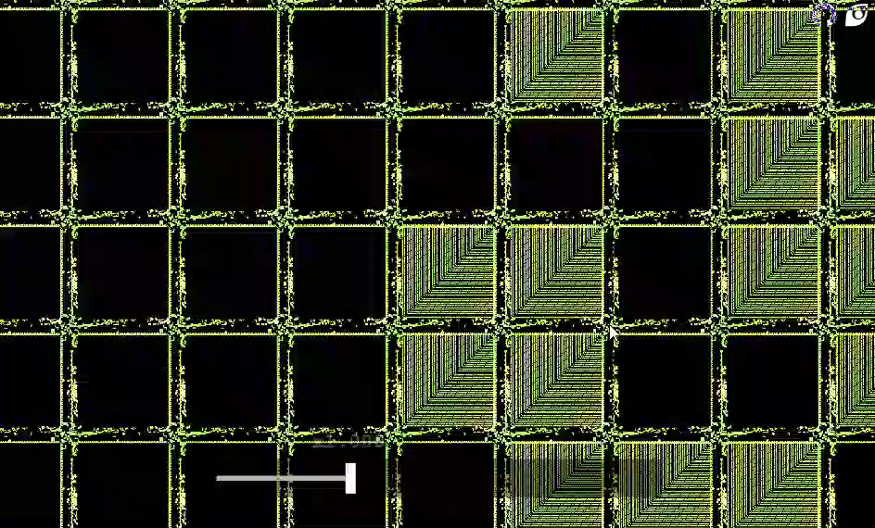
https://bit.ly/gol-in-gol

Slide 11
SELF-ORGANIZATION COLLECTIVE INTELLIGENCE CRITICALITY COMPUTATION

